Slide 1
Design Patterns

Slide 2
Design Patterns
Design patterns represent the best practices used by experienced object-oriented software developers.
Design patterns are solutions to general problems that software developers faced during software development.
These solutions were obtained by trial and error by numerous software developers over quite a substantial period of time.

Slide 3
Usage of Design Pattern
Common platform for developers
Design patterns provide a standard terminology and are specific to particular scenario. For example, a singleton design pattern signifies use of single object so all developers familiar with single design pattern will make use of single object and they can tell each other that program is following a singleton pattern.

Slide 4
Usage of Design Pattern
Best Practices
Design patterns have been evolved over a long period of time and they provide best solutions to certain problems faced during software development. Learning these patterns helps inexperienced developers to learn software design in an easy and faster way.

Slide 5
Types of Design Patterns
As per the design pattern reference book Design Patterns - Elements of Reusable Object-Oriented Software , there are 23 design patterns which can be classified in three categories: Creational, Structural and Behavioral patterns.

Slide 6
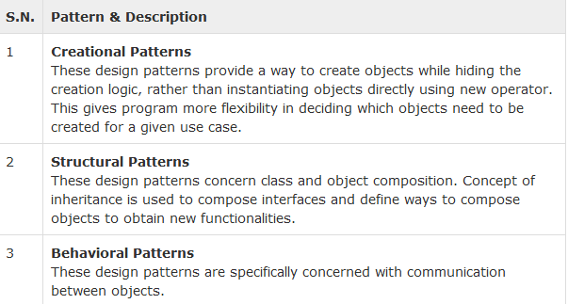
Types of Design Patterns

Slide 7
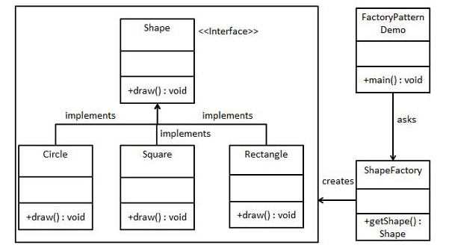
Home work
Implement the following scenario.

